Slide 1
BACTERIAL MENINGITIS
DR.SRINIVAS

Slide 2
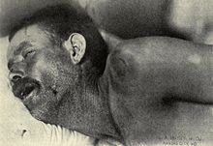
WHAT IS THE PROBABLE PHYSICAL ABNORMALITY?

Slide 3
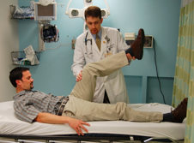
NAME THIS SIGN AND DESCRIBE IT?

Slide 4
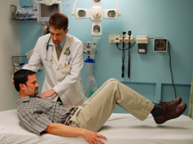
NAME THIS SIGN AND DESCRIBE IT?

Slide 5
CLASSIC TRIAD OF MENINGITIS
WRITE DOWN COMBINATION
1. HEADACHE
2. HIGH GRADE FEVER
3. PHOTOPHOBIA
4. VOMITING
5. NECK RIGIDITY
6. SEIZURES
7. ALTERED BEHAVIOUR

Slide 6
COMMONEST ORGANISM
COMMONEST ORGANISM CAUSING MENINGITIS IN ADULT?
CLOSTRIDUM.DIFFICILE
STAP.AUREUS
STREP.PNEUMONIAE
E.COLI
LISTERIA

Slide 7
COMMONEST ORGANISM
COMMONEST ORGANISM CAUSING MENINGITIS IN NEWBORN?
E.COLI
LISTERIA
STREPTOCOCCUS
STAPHYLOCOCCUS

Slide 8
CHOOSE TEST
CHOOSE ONE MOST APPROPRIATE TEST FROM THE FOLLOWING IN A CASE OF MENINGITS?
ABGA
U/S ABDOMEN
CHEST X-RAY
CSF ANALYSIS
CBC
RENAL FUNCTION TEST

Slide 9
BED SIDE TEST
WHAT BED SIDE TEST YOU HAVE TO DO BEFORE PROCEEDING FOR LUMBAR PUNCTURE? AND WHY?
B.P
FUNDUS EXAMINATION
U/S ABDOMEN
LOOKING FOR MENINGEAL SIGN

Slide 10
28YR OLD GIRL CAME TO THE HOSPITAL WITH H/O 2DAYS OF HIGH GRADE FEVER,ALTERED SENSORIUM,VOMITING,PHOTOPHOBIA.WHAT NEURO RADIOLOGICAL INVESTIGATION YOU ARE GOING TO ASK?
1. CT CEREBRAL ANGIOGRAM
2. CT BRAIN
3. CONVETIONAL ANGIO

Slide 11
TREATMENT
35 YR OLD MALE BROUGHT TO THE EMERGENCY ROOM WITH H/O FEVER,HEADACHE,ALTERED SENSORIUM,PHOTOPHOBIA,VOMITING.YOU HAVE DID EXAMINATION FOUND CLAASIC TRIAD OF MENINGITS WITH MENIGIAL SIGNS.FUNDUS EXAMINATION SHOWS PAPILLOEDEMA.LUMBAR PUNCTURE WAS POSTPONED.

Slide 12
TREATMENT contd…
WHICH IS THE MOST APPROPRIATE ANTIBIOTIC FOR THIS PATIENT? WHICH ROUTE IS BETTER FOR ADMINISTRATION OF DRUGS?
CEFTRIAXONE
CIPROFLOXACIN
GENTAMYCIN
AZITHROMYCIN

